Slide 1
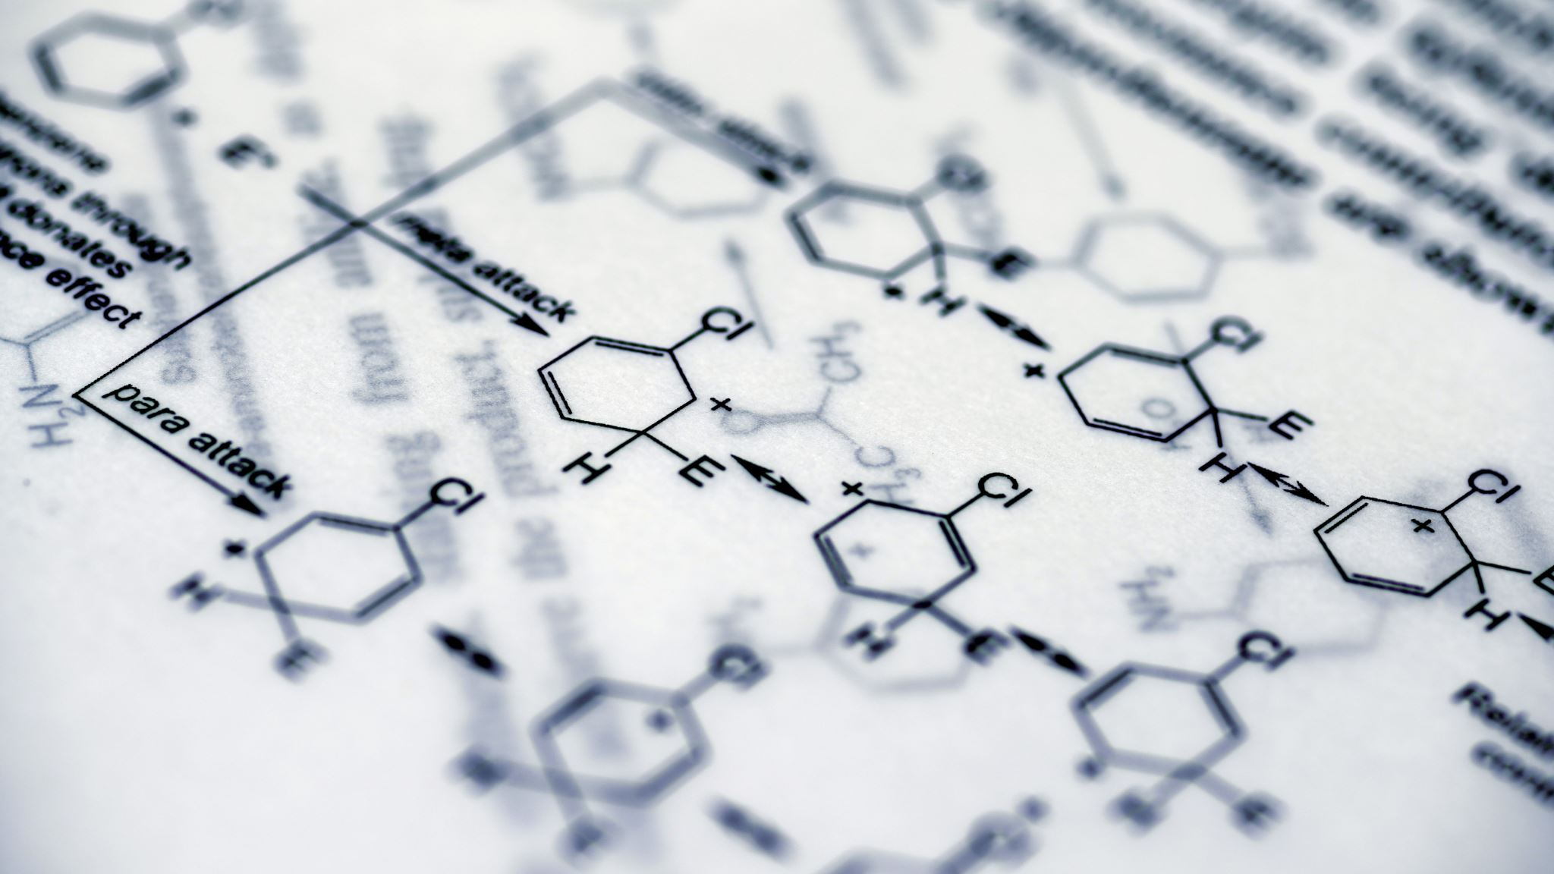
Text Analysis Semi- and Unsupervised ML: Topic Modeling and KeyATM
Day 3
Namig Abbasov, PhD
Digital Humanities Analyst
Data Science and Analytics

Slide 2
Unsupervised Learning Reminder
No labels
Primary tasks
clusters: K-means
associations: Apriori
dimensionality reduction: PCA
Complexity
unpredictable results
No one true answer: more interpretation
Domain knowledge

Slide 3
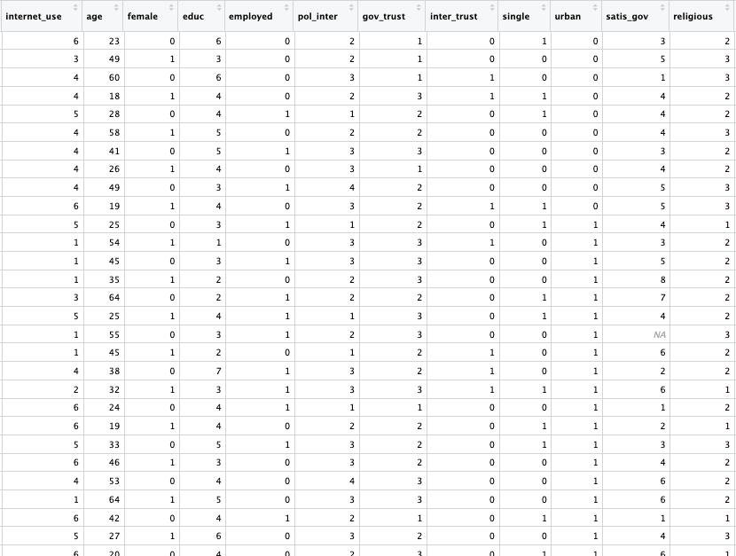
What do actually labels mean?

Slide 4
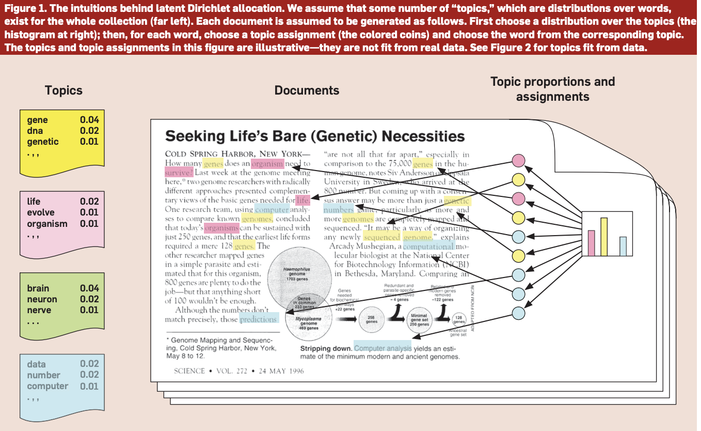
What is Topic Modeling?
Text analysis method to discover abstract "topics" in a collection of documents- corpus
a "topic" is a cluster of words with associated probabilities.
For instance, Topic 1: "government," "election," "policy," and "vote" with high probabilities. ➔so politics
Types
Latent Dirichlet Allocation (LDA)
Structural Topic Model (STM)
keyATM
more and more…
Blei, D. M. (2012). Probabilistic topic models. Communications of the ACM, 55(4), 77-84.

Slide 5
Unsupervised Learning: Text Classification vs. Topic Modeling
Text Classification
1 | Stocks Sink as Stubborn Inflation Resets. | Business
2 | Biden Denounces Trump’s Support for Russian Attack on Allies as ‘Un-American’ | Politics
3 | This Arctic Circle Town Expected a Green Energy Boom | Climate Change
 | Topic Modeling
1 | I love driving my car on the open road
2 | The engine of my vehicle is very powerful
3 | Libraries have thousands of books to read
4 | Reading a good book is a joy
5 | Cooking fresh meals is therapeutic
6 | A kitchen is a place where meals are made
Topic 1: {car, driving, engine, vehicle, road}
Topic 2: {libraries, books, read, joy}
Topic 3: {cooking, meals, therapeutic, kitchen}

Slide 6

How Does It Work?
Initial Assignment
Iterative Refinement
Document-Topic: How prevalent is a topic within a given document?
Word-Topic: How prevalent is a word across a given topic throughout all documents?

Slide 7
Dirichlet Distribution
Documents are probability distributions over latent topics
For each document, we get a probability distribution over topics.
Topics are probability distributions over words
For each topic, we get a probability distribution over words.
80% Topic 1
15% Topic 2
5% Topic 3
Topic 1:
The presence of ”halloween", ”pumpkins", ”treats” with high probabilities in Topic 1 suggests the topic is about Halloween.
Document A:

Slide 8
Document-topic distributions
My (Fake) Corpus
"I love driving my car on the open road."
"The engine of my vehicle is very powerful."
"Libraries have thousands of books to read."
"Reading a good book is a joy."
"Cooking fresh meals is therapeutic."
"A kitchen is a place where meals are prepared."
Iterative Refinement
Topic 1: {car, driving, engine, vehicle, road} (vehicles)
Topic 2: {libraries, books, read, joy} (reading)
Topic 3: {cooking, meals, therapeutic, kitchen} (cooking)
"I love driving my car on the open road." - Mostly Topic 1 (vehicles)
1
"The engine of my vehicle is very powerful." - Mostly Topic 1 (vehicles)
2
"Libraries have thousands of books to read." - Mostly Topic 2 (reading)
3
"Reading a good book is a joy." - Mostly Topic 2 (reading)
4
"Cooking fresh meals is therapeutic." - Mostly Topic 3 (cooking)
5
"A kitchen is a place where meals are prepared." - Mostly Topic 3 (cooking)
6
"I love driving my car on the open road."
Topic 1: 80%
Topic 2: 10%
Topic 3: 10%

Slide 9
Applications
Business and Marketing
Customer feedback
Content recommendation
Market research
Healthcare
Medical research
Public health
Media and Publishing
News aggregation
Content Summarization
Academic research
Social sciences
Digital Humanities
Cultural analysis
Historical research

Slide 10
Structural Topic Models(STM)
Topic models are powerful for identifying major topics in corpus.
But what about making inferences based on covariates(meta data)
Which countries are more vocal against Russian occupation of Ukraine?
Are there relationship between regime type and UNGD speeches?
Are authoritarian regimes more expressive of sovereignty?
Solution: STM
Integrates LDA with regression to create a unified generative model based on covariates
Offers enhanced tools to interpret the results of the topic model.
Estimates two outcomes: topic relevance and topic content

Slide 11

Challenges for Topic Modeling
How many topics?
Interpreting meaning of topics
Overlapping topics
Generalizing from a model
Polysemy and Homonymy
Language and Cultural Nuances
Hyperparameter Tuning
Evaluation Difficulties
Handling Short Texts
Twits

Slide 12
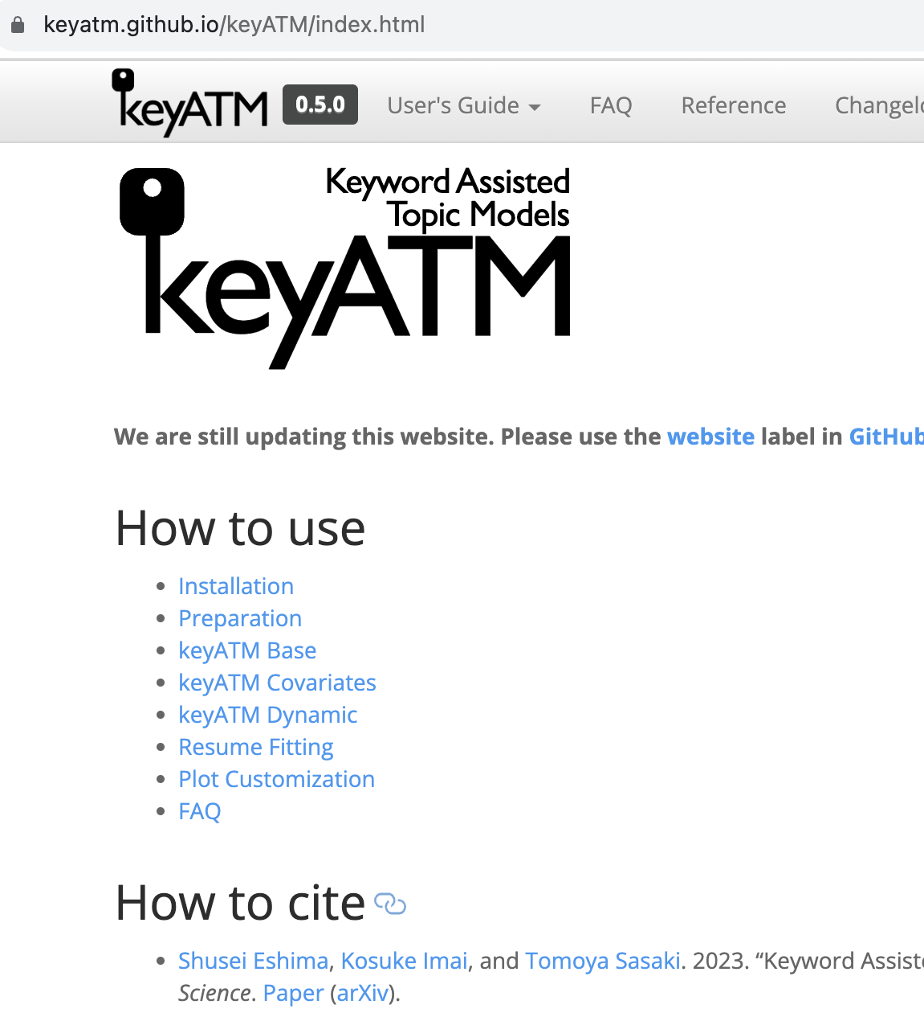
Keyword Assisted Topic Model- keyATM
combines traditional unsupervised topic models with a supervised components.
allows the researcher to specify keywords for certain topics.
incorporates previously specified keywords to give them higher probabilities in the specified topics.

Slide 13
Why keyATM?
Incorporating domain knowledge
Better interpretability
Addressing model uncertainty

